Slide 1

Notes:
Challenge—Connect all nine dots together with 4 lines without taking your pencil off the paper.

Slide 2
Notes:
To solve the problem you have to think outside the box. Sometimes we box ourselves into thinking we have to run our county Farm Bureau or our business the way we’ve always done it.

Slide 3

Brainstorming
Innovative Thinking
Notes:
Brainstorming can be an effective way to think outside the box and generate lots of ideas on a specific issue.

Slide 4

Group
Brainstorming
Notes:
Group brainstorming brings people together to solve and problem or create an opportunity. It lends itself well to county board meetings as it is most effective in groups of 8-12 people.
WHY DO IT?
People bring different strengths, ideas, experiences and opinions to the table. It gives an opportunity to participants to expand existing knowledge by building on each other’s contribution. You can develop ideas in greater depth in group brainstorming and people are more committed to the solution because they gave their input and played a part in developing the solution.

Slide 5

The Opportunity
Your community is starting a new Days of the West Festival that will be held the last weekend in August. The festival organizer has approached your county Farm Bureau to host an event highlighting agriculture during the festival weekend.
You are meeting to brainstorm ideas for a family-friendly activity to host during the festival.
Notes:
Brainstorming should be done in a relaxed environment where everyone’s ideas hold the same weight. At the start of your meeting, write or display a problem statement on the wall.
Define your problem or issue as a creative challenge—this is extremely important. A badly designed challenge could lead to a lot of ideas—none of which solve the problem. The problem could be stated: “In what ways might we . . .?” How could we encourage more . . .”? “How could we . . .”?
Be concise, to the point, and exclude any information other than the challenge itself.

Slide 6

Brainstorming
Guidelines
Generate many, varied ideas
Think outside the box (Wild ideas are encouraged.)
Build on the ideas of others
Defer judgment (no criticism)
Stay on topic
Notes:
FACILITATOR
Every brainstorming session needs a facilitator who will guide the session, encouraging everyone to contribute (even the quietest). He or she also discourages anyone from criticizing ideas. It's important there is a spirit of non-judgment--if you don't, people will clam up and the effectiveness of the group is diminished. Another important responsibility of the facilitator is to refocus the group when they become sidetracked.
GUIDELINES
Generate many, varied ideas
Think outside the box (wild ideas are encouraged)
Build on the ideas of others
Defer judgment
Stay on topic
Good brainstormers don't waste time tearing down ideas. Instead, they either improve on the idea by adding something to it or generate a new idea. You never know which idea might spark something great.

Slide 7
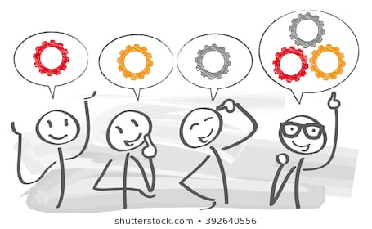
Then. . .
build on each others’ ideas.
Notes:
When building on the ideas of others, show acceptance of the idea and add to it using the phrase "Yes, and" instead of "No, because".

Slide 8
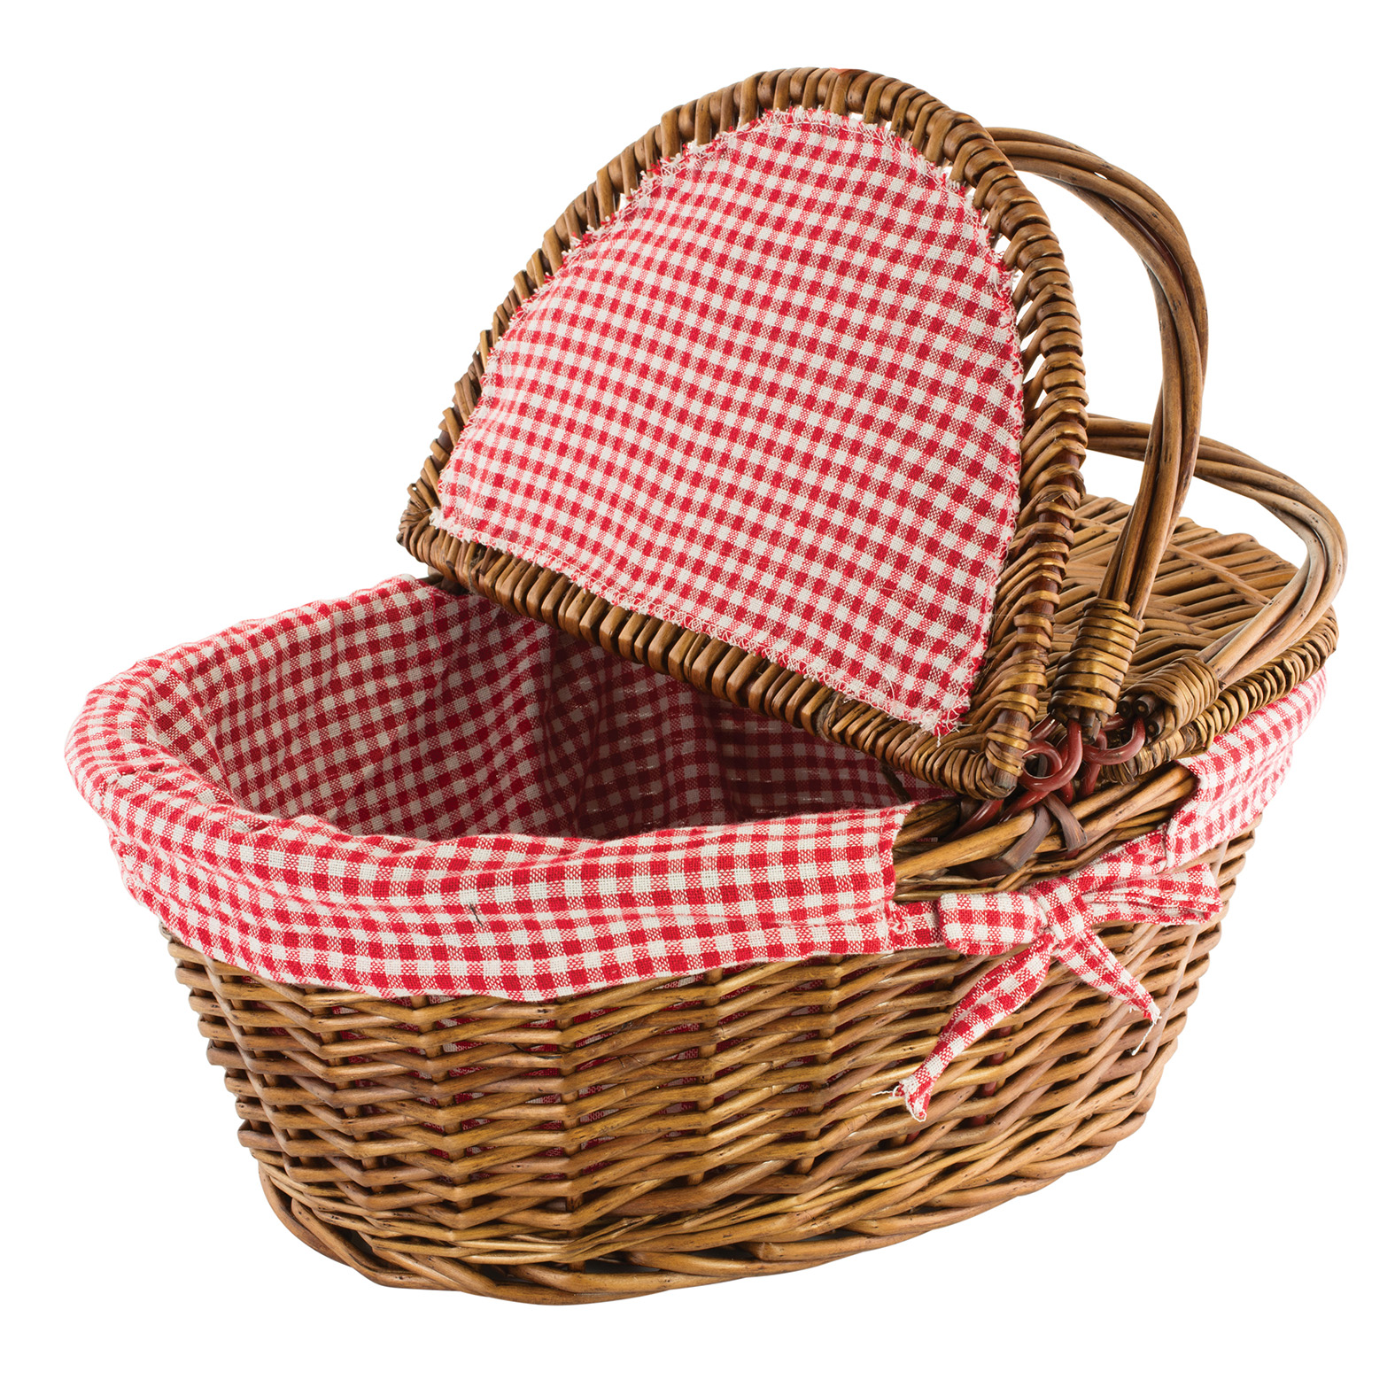


Yes, and. . .
Notes:
Yes, and is a principle of improv—you accept someone’s idea and add to it—Yes, and . . .
For example, let’s say that someone contributes the idea—let’s have Farm Bureau host a picnic in the park. The next person might say, YES, and we could give out wicker picnic baskets with our logo on it. The next person adds, YES, and we could get donations from local food producers to showcase what is grown in our county. Another adds, I know someone at Woolgrowers, and maybe they could donate some picnic blankets for prizes. You see the process. YES and instead of that won’t work because. . .

Slide 9
How to
Set a time limit
Set an idea goal
Write down all ideas—no criticism
Notes:
Give yourself a time limit. Depending on your group size we recommend 10 minutes. Larger groups need more time to get everyone’s ideas. Give yourself a idea limit, 25-50.

Slide 10
Begin Evaluating
Look for answers that are repeated or similar
Group similar concepts together
Eliminate responses that definitely do not fit
Select 5 ideas you like best
Evaluate them against the criteria
Identify the best idea
Notes:
Taste of the County and Family Picnic might be similar, so group them together.

Slide 11
What’s the
Criteria?
Write down criteria for judging the ideas.
Should . . .
be cost effective
be impactful—best outcome
use available volunteer strengths & resources
represent local agriculture
be possible to finish by August 15

Slide 12


Notes:
It’s easy to get trapped in the box of the same old thinking. Working together and involving new people in your counties to brainstorm new solutions or new opportunities for your organization can reap benefits in membership, volunteerism, and impact.

